Slide 1
Methods of estimating CO₂ emissions
Bessie Bao

Slide 2
Contents
Data representations
2 Methods of estimating CO₂ emissions

Slide 3
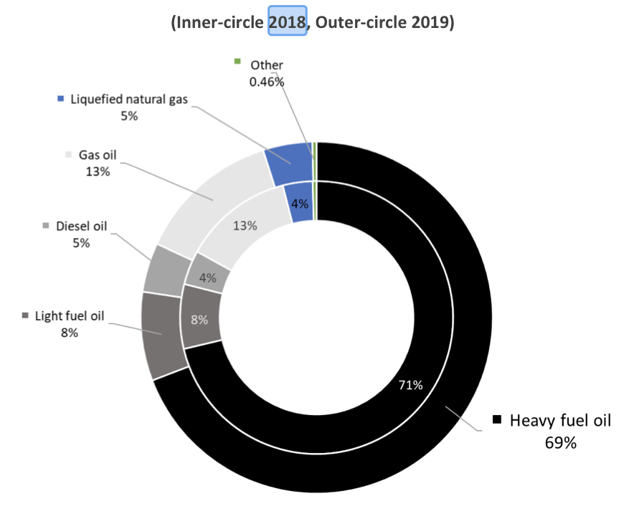
Paper 1: 2020 Annual report on CO₂ emissions from maritime transport
Methodology
Emissions calculated based on fuel consumption at individual ship level (based on specific emission factors for every fuel type)
Main findings
Fuel consumption:
Heavy fuel oil contributes 69% of the total fuel consumption in 2019, compared to 71% in 2018.

Slide 4
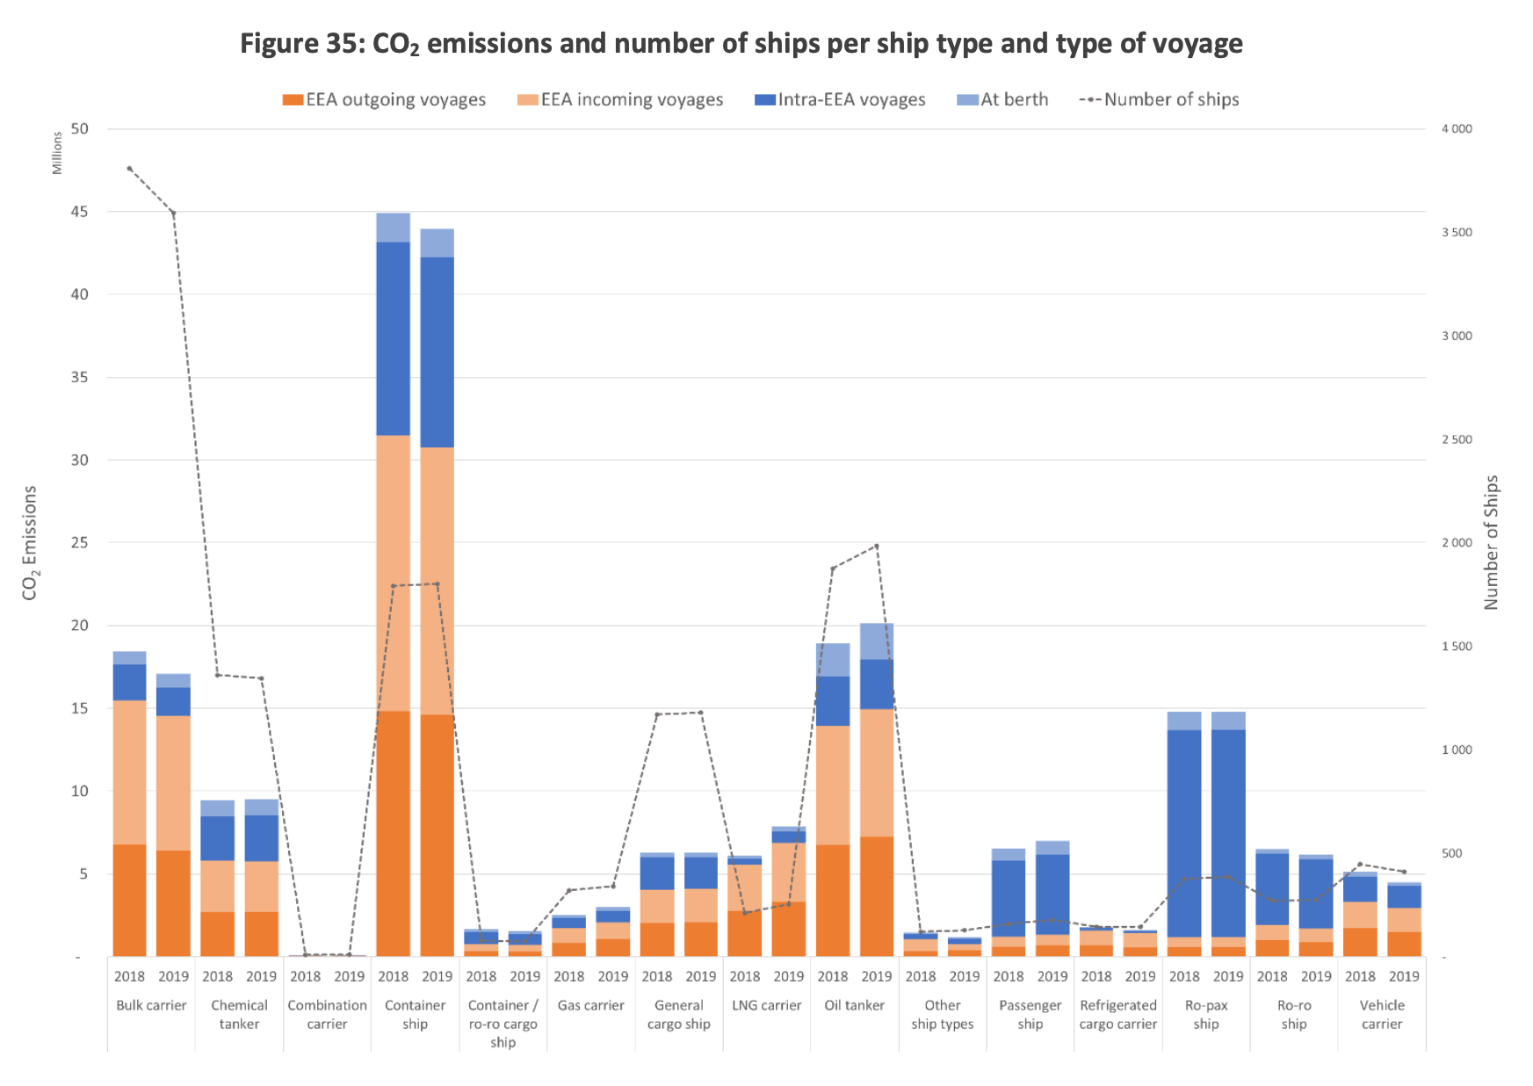
CO₂ emissions and types of ship in 2018 and 2019
Main findings
144.6 million tons of CO₂ emission in 2019, compared to 138 million tons in 2018.
Container ships represent the largest share (30%) in 2019, compared to 31% in 2018.

Slide 5
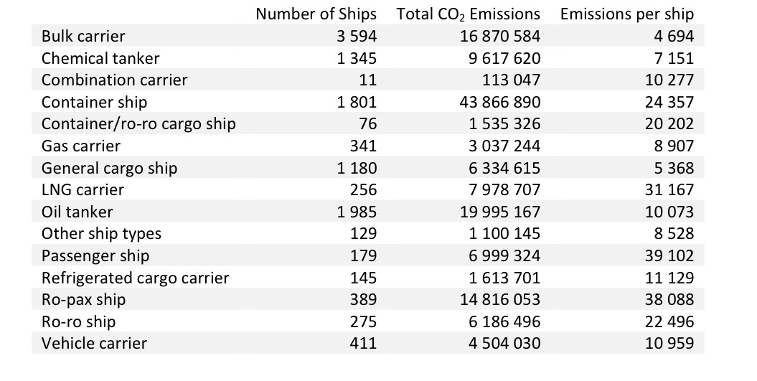
Total emissions in 2019 from different types of ships
Main findings
Container ships represent the largest share of total emissions (30% of the total emissions in 2019).
Bulk carriers contribute about 30% of the total number of monitored fleet.
Emissions from oil tankers and chemical tankers altogether contribute around 20% of all CO₂ emissions.

Slide 6
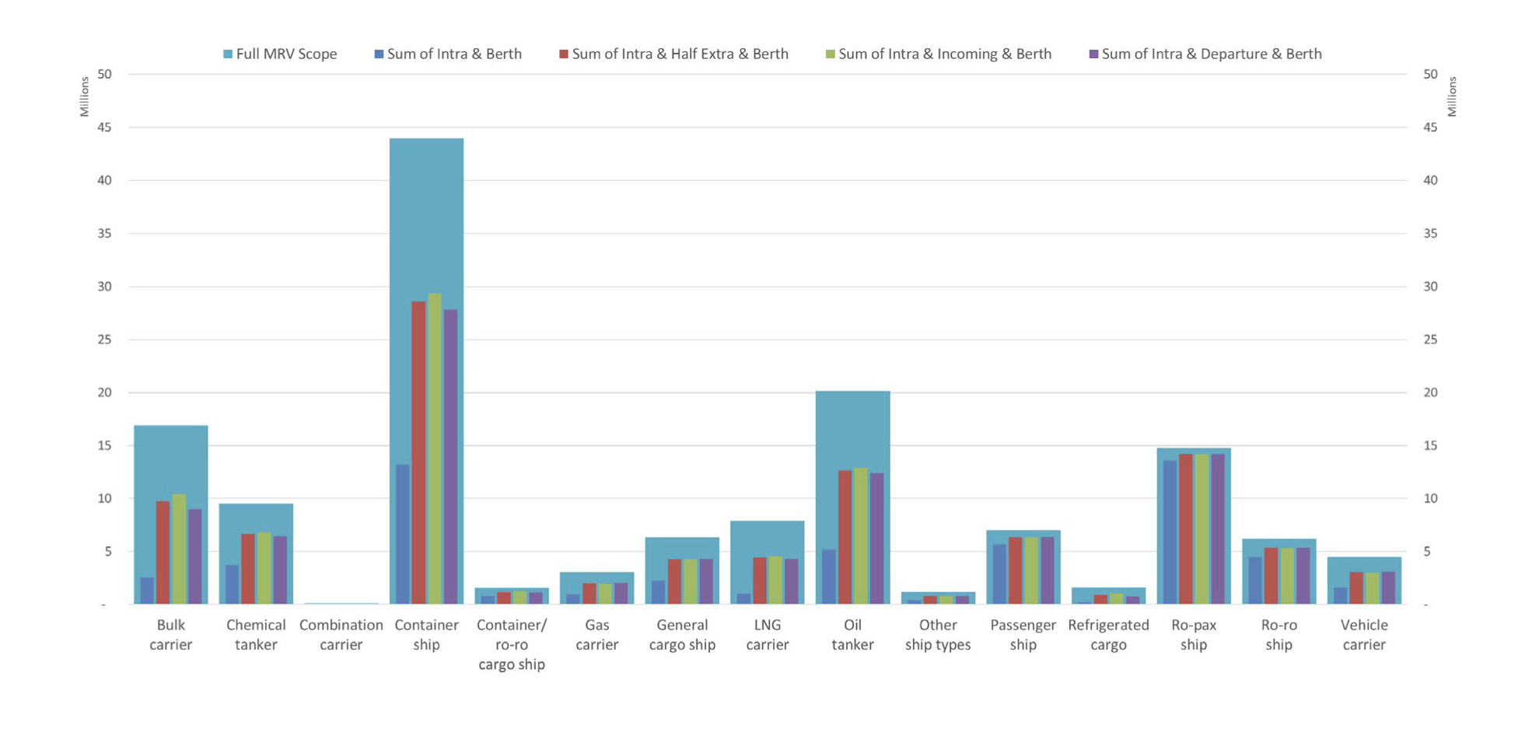
Emissions per type of voyages and by ship type in 2019
Main findings
Container ships contribute the most in CO₂ emission combining all types of voyages in 2019.
Container ships contribute the most in all four types of voyages except for the emission sum of intra and berth.

Slide 7
Comparisons between technical energy efficiency and operational energy efficiency
Technical energy efficiency
EEDI: minimum energy efficiency level per ton mile
EIV: simplified version of the EEDI
Operational energy efficiency
AER: ratio between emissions and the maximum transport work based on the cargo carrying capacity in 70% of DWT or GT.
EEOI: ratio of mass of CO₂ emitted per unit of transport work.

Slide 8
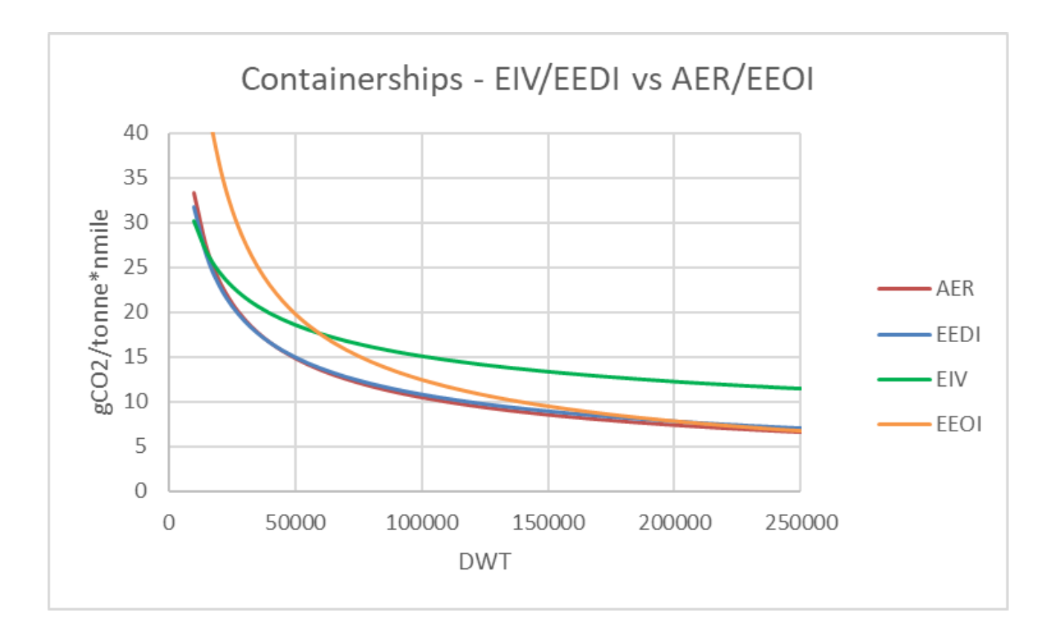
Comparisons between technical energy efficiency and operational energy efficiency
Better Operational energy efficiency than technical energy efficiency before EEDI.
Operational energy efficiency converges to EEDI values due to operating closer to their design reference speed.
EEOI is generally higher than AER for small to medium-sized ships.

Slide 9
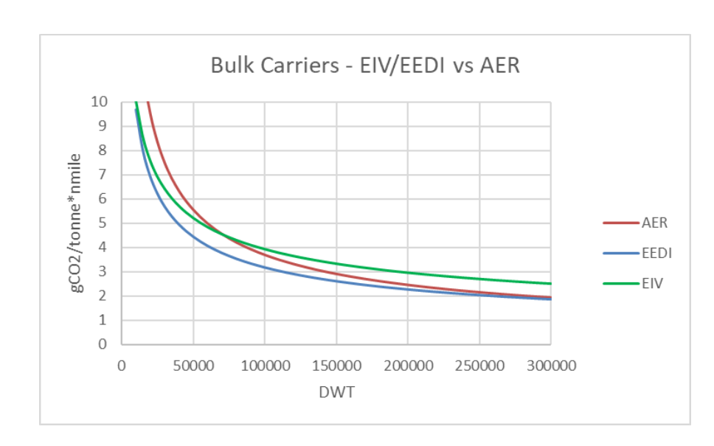
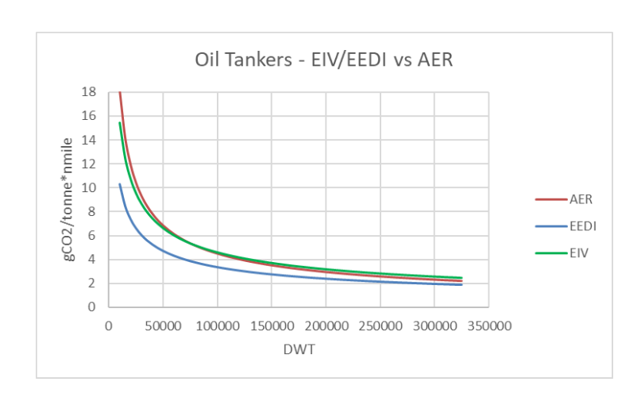
Comparisons between technical energy efficiency and operational energy efficiency
Short sea restricted manoeuvring profile for smaller ships
Fuel consumption efficiency is lower
AER worse than EEDI and EIV
Better operational performance than technical efficiency for larger bulkers.

Slide 10
Paper 2: Emission from international sea transportation and environmental impact
Main topic of interest
Changes in the atmospheric composition of pollutants (NO_{x} , SO₂, CO, CO₂, and volatile organic compounds (VOC), and greenhouse compounds due to emissions from cargo and passenger ships in international trade.
Methodology
Estimating emissions through fuel consumption (engine type and ship size categories) -- Exhaust gas emission equation
Estimating emissions in various geographical cells -- Modeled atmospheric emission equation
Data source
Distributions of cargo ships in international trade – AMVER
World fleet statistics of cargo and passenger ships above or equal to 100 gross tons.

Slide 11

Methodology
Exhaust gas emission equation (auxiliary engines excluded):
M_{g,i,k,s}: the amount of pollutant emitted of type g for ships of type i in size category k with engine type s, kg pollution;
c^{f}_{g,s}: the fuel-based emission factor for pollution type g in relation to engine type s, kg pollution/kg fuel;
F_{i,k,s}: the fuel consumption of vessels of type i in size category k with engine type s, kg fuel
b_{s}: the specific fuel consumption for engine type s, kg fuel/kW h;
m_{i,k}: the average engine load for a ship of type i and size category k, equals 0.7 approximately.
t_{i,k}: the average number of operating hours during a year for a vessel of type i and size category k, h/yr;
p_{i,k}: average installed engine power for a vessel of type i and size category k, kW;
n_{i,k}: the number of vessels of type i in size category k;
e_{i,k,s}: the fraction of vessels of type i in size category k with engine type s.

Slide 12
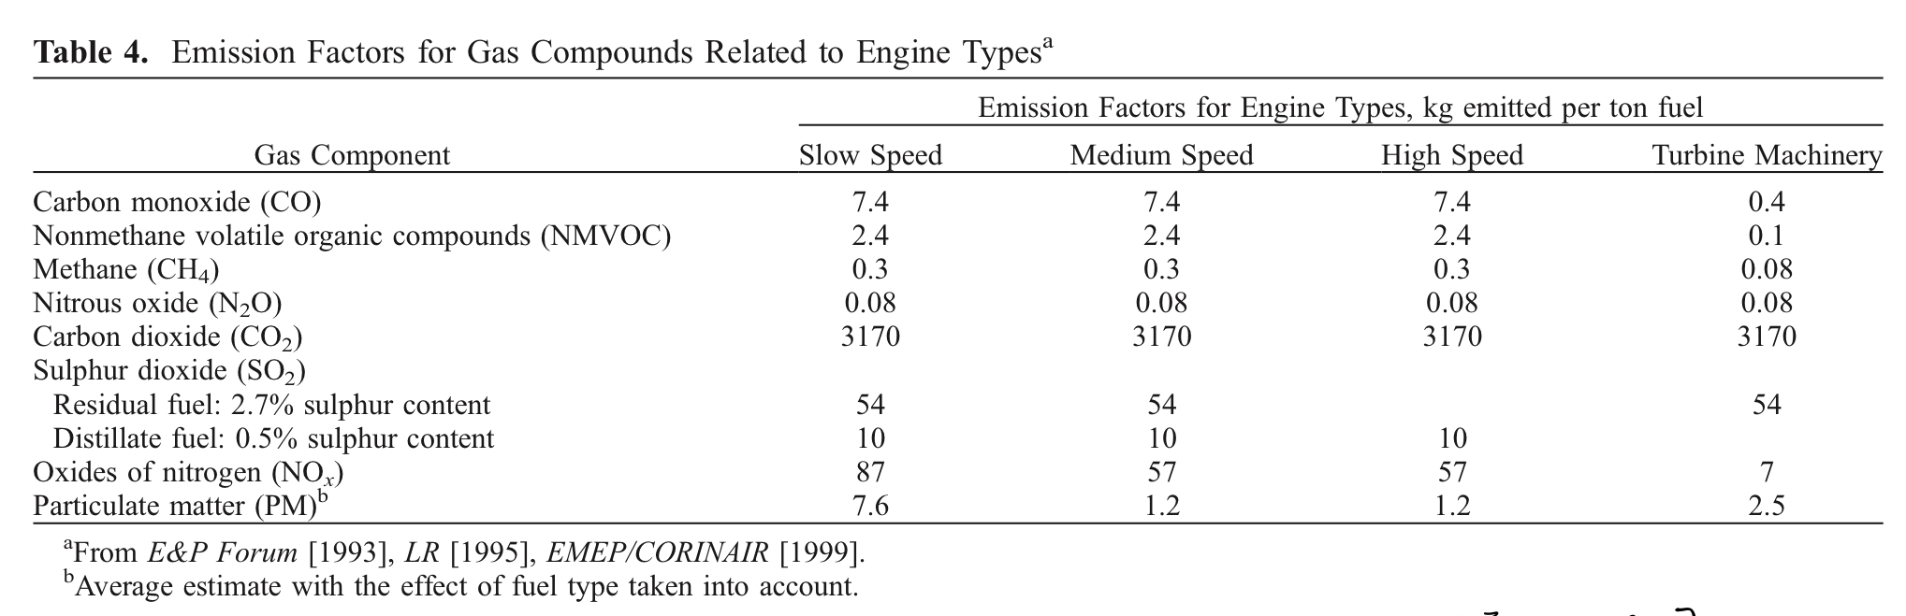
Methodology
Data for c^{f}_{g,s} (fuel-based emission factor for pollution):

Slide 13
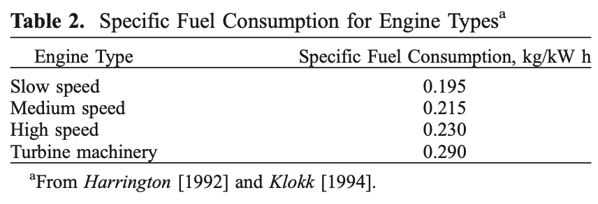
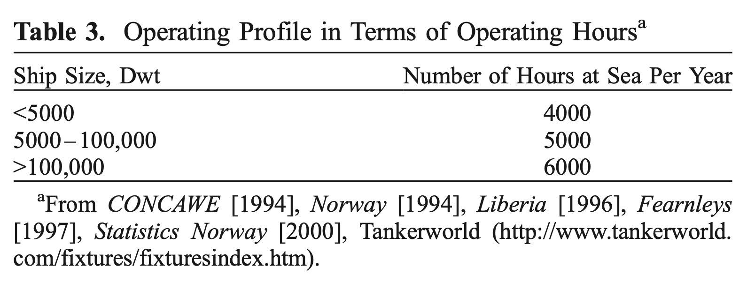
Data for b_{s} (specific fuel consumption for engine):
Methodology
Data for t_{i,k}: (average number of operating hours during a year for a vessel):

Slide 14
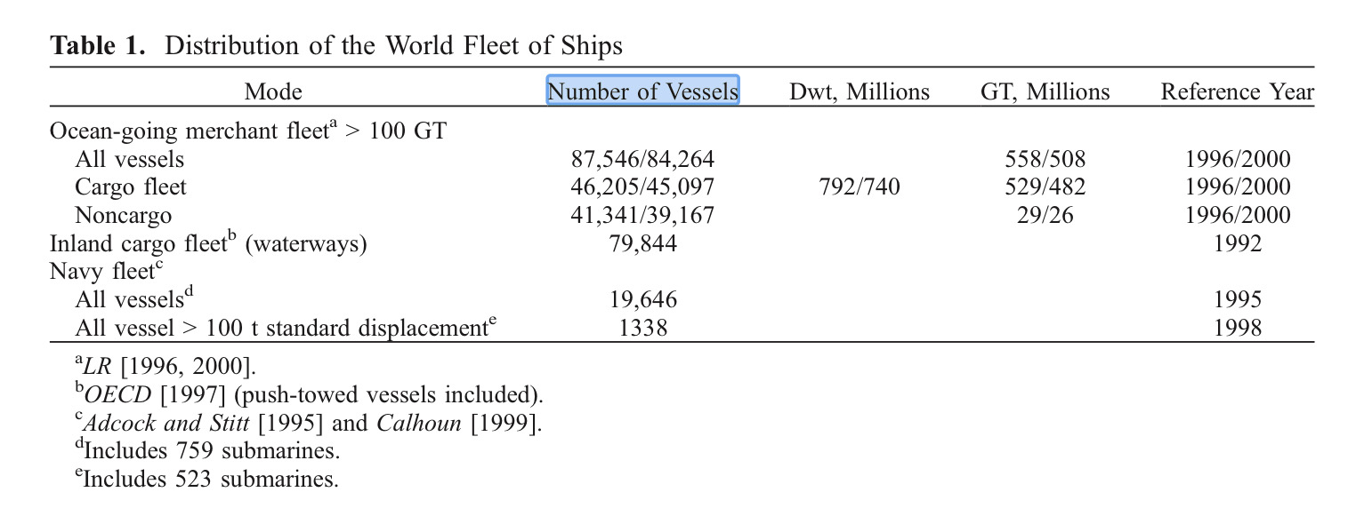
Methodology
1. Relationship between engine power and ship size, α_{i}∈[2.6, 39.8], βi∈[0.5,0.86].
P_{i,k}=α_{i}X^{βi}_{i,k}
P_{i,k}: average installed engine power
X^{βi}_{i,k}: average size of ships in size category k of type i.
2. Data for n_{i,k} (number of vessels of type i in size category k):
data from 4500 Det Norske Veritas (DNV) classed vessels)

Slide 15
Data for e_{i,k,s} (the fraction of vessels of type i in size category k with engine type s):
Large ships (>60,000 Dwt, and these between 12,000 and 60,000 Dwt) usually equipped with slow-speed engines. (50-80% depending on vessel type)
About 80% of vessels (between 2,000 and 12,000 Dwt) with medium-speed engines.
About 30% of the total ships has high-speed engines, depending on ship type)
Few ships have turbine machinery (2-15% of the large ships depending on ship type).

Slide 16
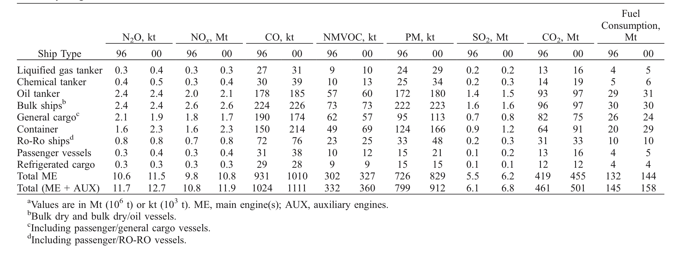
Table of ship type and exhaust gas emissions in 1996 and 2000:
CO₂ emissions of each ship type increase across time, except for the “general cargo” ad “refrigerated cargo” specifically.
Bulk ships contributes the most in CO₂ emission in 1996.
Both bulk ships and general cargo contribute the most in CO₂ emission in 2000.

Slide 17
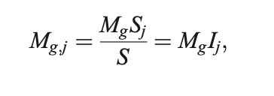
Methodology
Modeled atmospheric emission equation (auxiliary engines included): :
M_{g,j}: emissions for the individual exhaust gas component g in geographical cell j, kg pollution;
M_{g}: total emissions for the individual exhaust gas component g, kg pollution;
S: total number of ship observations or total accumulated GT of ships reporting;
S_{j}: number of ship observations or accumulated GT in cell j of ships reporting;
I_{j}: emission indicator in cell j, referring to relative reporting frequency or relative reporting frequency weighted by the ship size (given by GT).

Slide 18
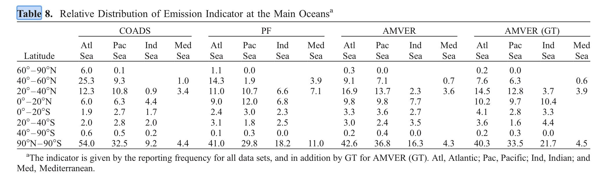
Data for I_{j} (emission indicator in cell j, representative for both year 1996 and 2000):
Data for M_{g} corresponds to the total emission data from the previous table.

Slide 19
An overview of CO₂ emission in various geographical cells
1996 Data
2000 Data
Latitude/sea area | Atl sea | Pac sea | Ind sea | Med sea
60°-90°N | 92200000000 | 0 | 0 | 0
40°-60°N | 3.5036E+12 | 2.9043E+12 | 0 | 2.766E+11
20°-40°N | 6.6845E+12 | 5.9008E+12 | 1.7057E+12 | 1.7979E+12
0°-20°N | 4.7022E+12 | 4.4717E+12 | 4.7944E+12 | 0
0°-20°S | 1.8901E+12 | 1.2908E+12 | 1.5213E+12 | 0
20°-40°S | 1.6596E+12 | 7.376E+11 | 2.0284E+12 | 0
40°-90°S | 92200000000 | 1.383E+11 | 0 | 0
90°N-90°S | 1.85783E+13 | 1.54435E+13 | 1.00037E+13 | 2.0745E+12
Latitude/sea area | Atl sea | Pac sea | Ind sea | Med sea
60°-90°N | 1.002E+11 | 0 | 0 | 0
40°-60°N | 3.8076E+12 | 3.1563E+12 | 0 | 3.006E+11
20°-40°N | 7.2645E+12 | 6.4128E+12 | 1.8537E+12 | 1.9539E+12
0°-20°N | 5.1102E+12 | 4.8597E+12 | 5.2104E+12 | 0
0°-20°S | 2.0541E+12 | 1.4028E+12 | 1.6533E+12 | 0
20°-40°S | 1.8036E+12 | 8.016E+11 | 2.2044E+12 | 0
40°-90°S | 1.002E+11 | 1.503E+11 | 0 | 0
90°N-90°S | 2.01903E+13 | 1.67835E+13 | 1.08717E+13 | 2.2545E+12
CO₂ emissions in all observed geographical cells increased.
Highest emissions in Atlantic sea 90°N-90°S.

Slide 20
Paper 3: Emissions from international shipping: 1. The last 50 years
Topic of interest:
Modeling total fuel consumption and emissions
Comparisons of emissions from international shipping between 1950 to 2001
Methodology
Bottom-up analysis
Activity-based approach to estimate emissions through fuel consumption data in recent years

Slide 21
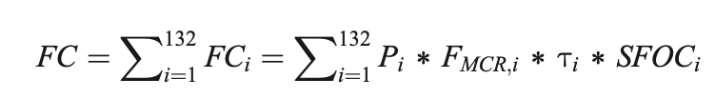
Methodology (exact calculation for recent data)
Bottom-up analysis
All civilian ships of the fleet in 2001
Calculations of total fuel consumption
FC: fuel consumption (tons/year)
P_{i}: accumulated installed engine power (MW)
F_{MCR,i}: engines’ average load based on duty cycle profiles (%)
Τ_{i}: average annual engine running hours (hrs/year)
SFOC_{i}: power-based specific fuel-oil consumption rate (kg/kWh)
6 main ship classes + auxiliary engines
132 engine subgroups
Methodology (approximation for earlier data)
Fuel consumption amount = accumulated installed engine output * fuel amount burnt in the preceding year
Correct the consumption by the assumed change in annual running hours and SFOC.

Slide 22
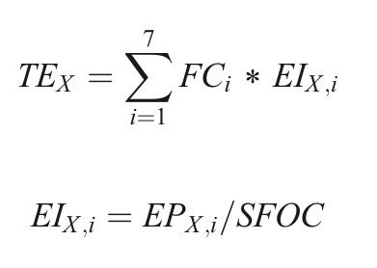
Methodology
Calculations of total emissions using fuel consumption:
EI_{X,i}: emission factors of the pollutants X (kg/ton fuel)
EP_{X,i}: power-based emission factor (g/kWh)
SFOC_{i}: power-based specific fuel-oil consumption rate (kg/kWh)
TEx : total emissions of each main type of ships
FC_{i}: total fuel consumption of each engine sub-group (132 in total)

Slide 23
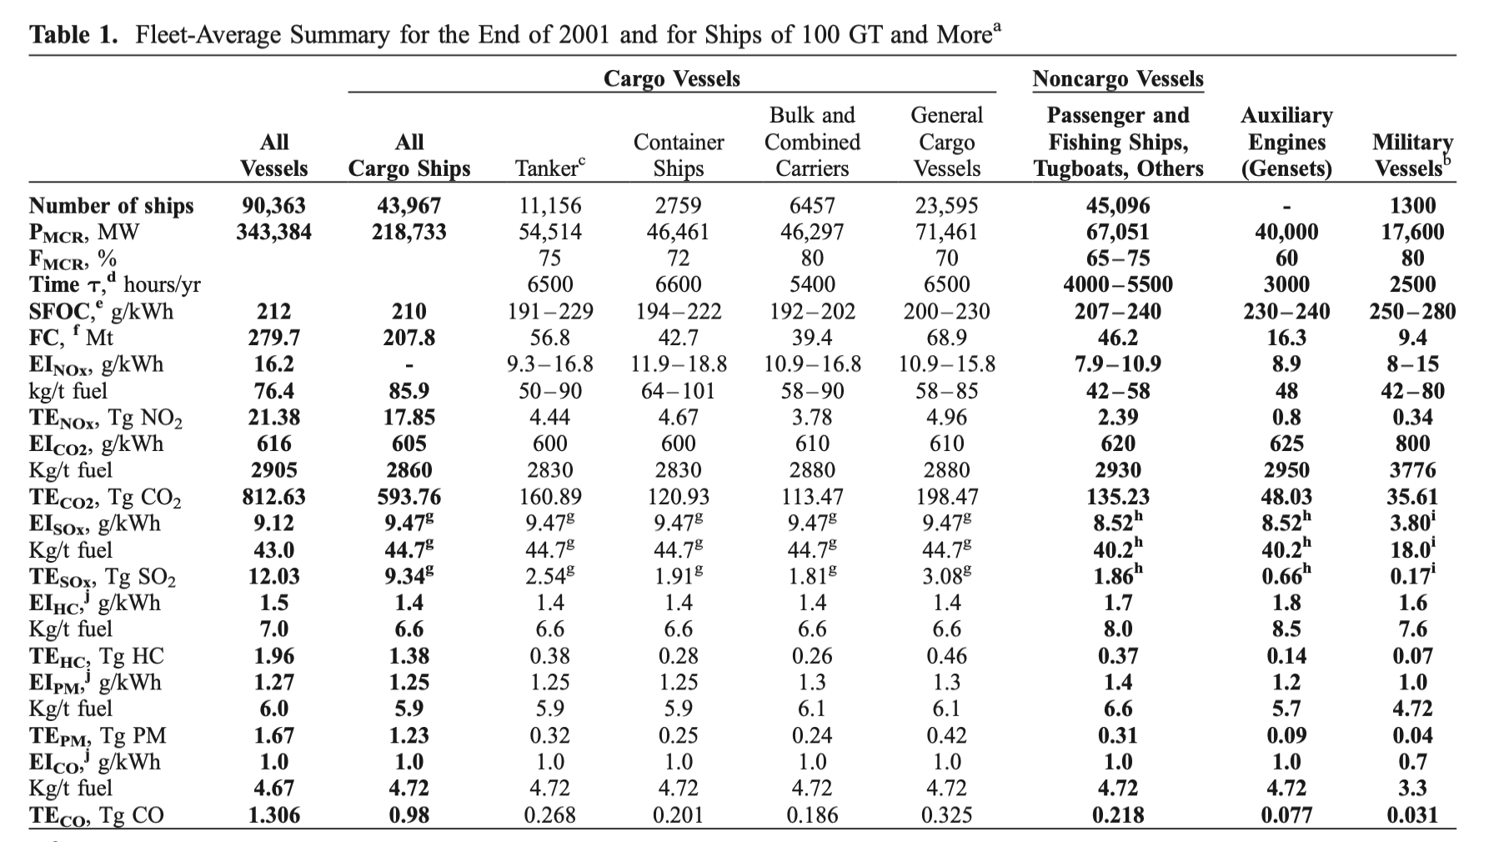
An overview of the CO₂ emissions through fuel consumption calculations

Slide 24
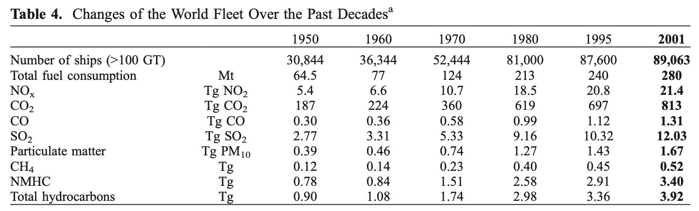
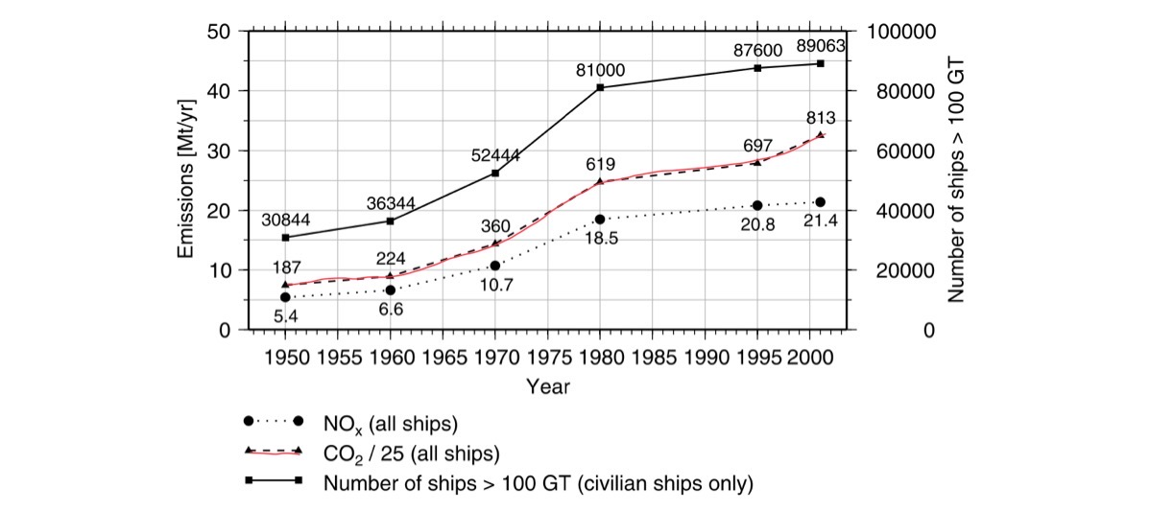
Trend of the CO₂ emissions through calculations of fuel consumption
A rapid increase in the number of ships and the introduction of container vessel around 1973 to 1975
Higher average installed engine power per ship overtime leads to higher fuel consumption and CO₂ emission per ship.
Increasing trend of fuel consumption and CO₂ emissions

Slide 25
Sources for the papers
Paper 1: https://ec.europa.eu/clima/system/files/2021-08/swd_2021_228_en.pdf
Paper 2: https://www.semanticscholar.org/paper/Emission-from-international-sea-transportation-and-Endresen-Sørgård/71dfedbf4a2c127c16bdae1aef66ca46af1570d5
Paper 3: https://agupubs.onlinelibrary.wiley.com/doi/epdf/10.1029/2004JD005619

Slide 26
Thank you for listening!

